Slide 1


Embracing Failure: Web Development with Scala learning path
Lessons from Building a Web App with the TypeLevel Stack
Olga Mazhara
Software Engineer
Notes:
"Hello everyone! Thanks for joining me today. I’m [Your Name], a software engineer with a big data background who’s recently navigated a transition into web development with functional programming. Today, I’m excited to share my real-world journey of building a web app for the Franco-Ukrainian Toloka Association, specifically a library management system. It’s been quite the ride, full of challenges, setbacks, and some surprising takeaways that I believe can be helpful to anyone working in functional programming. Let's dive in!"

Slide 2
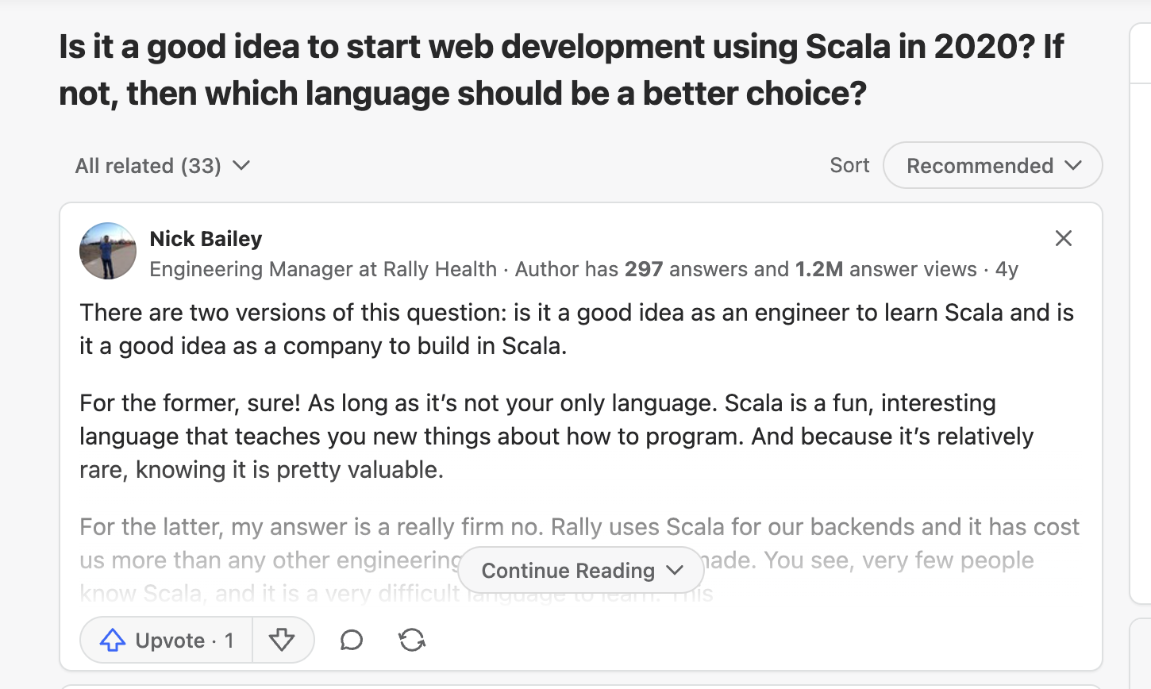
Notes:
https://www.quora.com/Is-it-a-good-idea-to-start-web-development-using-Scala-in-2020-If-not-then-which-language-should-be-a-better-choice

Slide 3
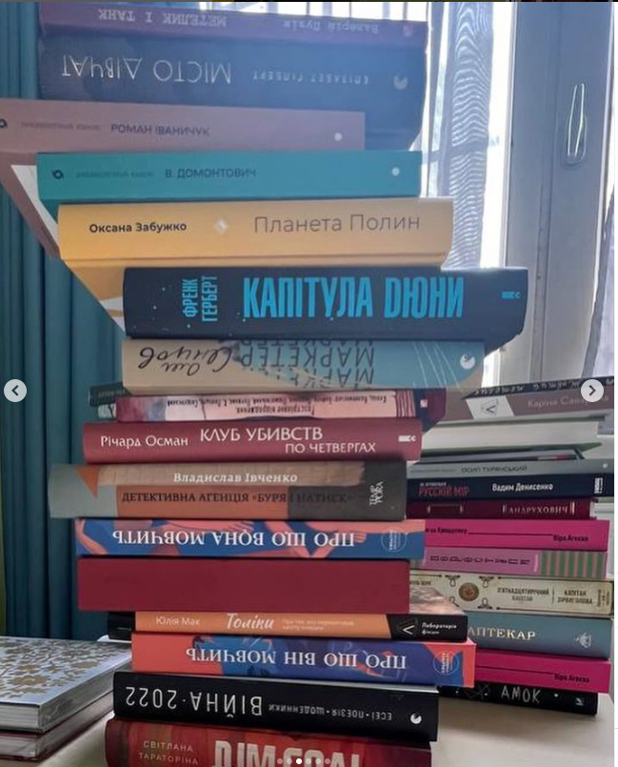

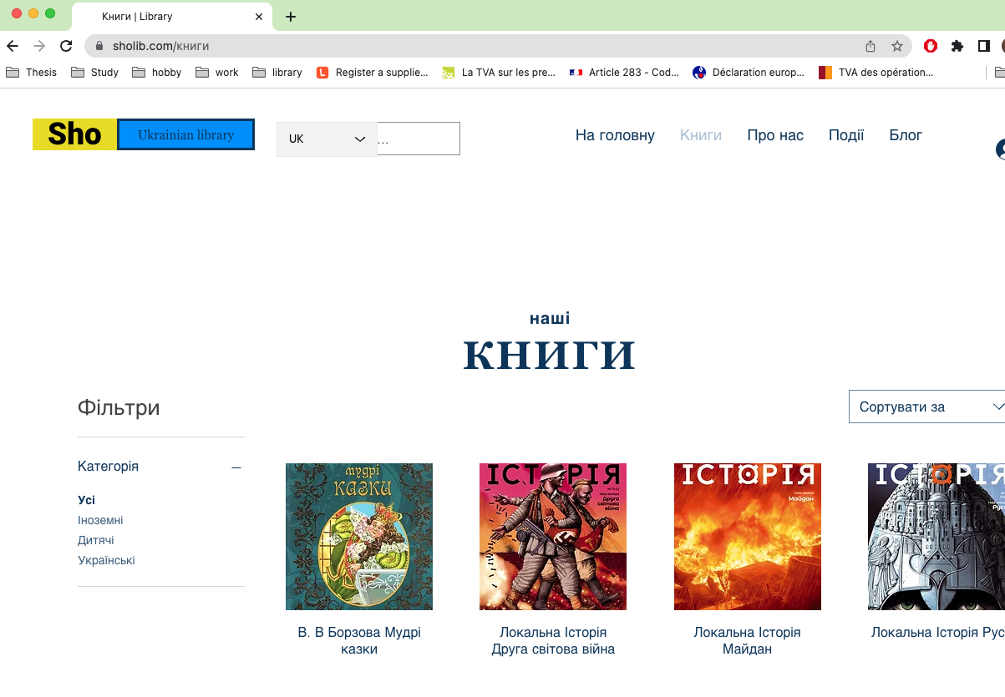

The Shift from Big Data to Web Development
"From Hopeful to Humbled"
Not big deal
Notes:
"So, after years working in big data, I found myself drawn to web development. But it wasn’t exactly a smooth transition. You see, moving from a data-focused role to web development meant tackling new tools, a different pace of work, and many more frontend-backend interactions than I was used to. I quickly learned that this area of functional programming has its own unique challenges."

Slide 4
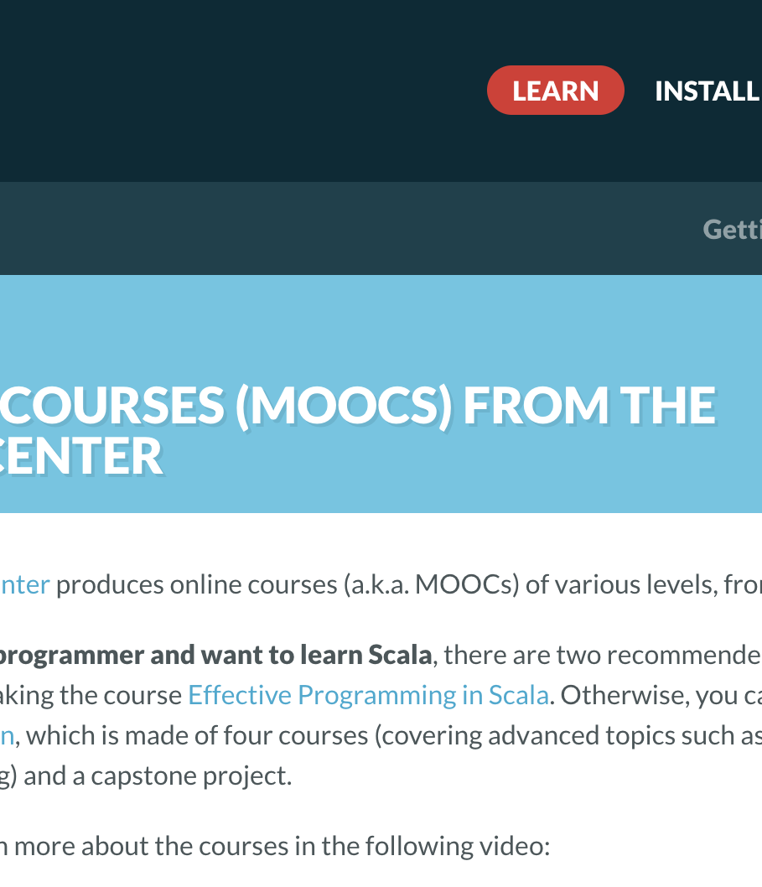
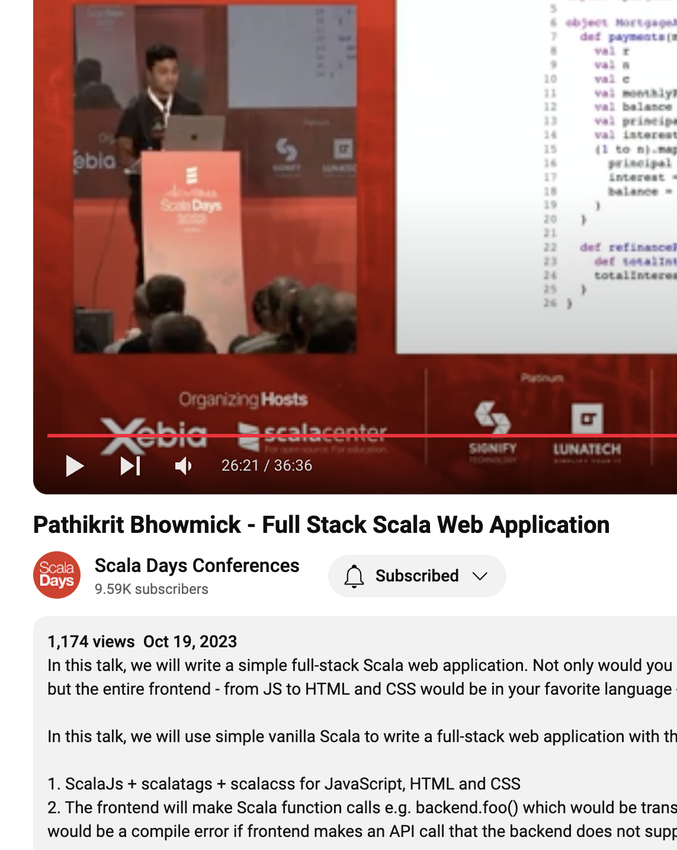
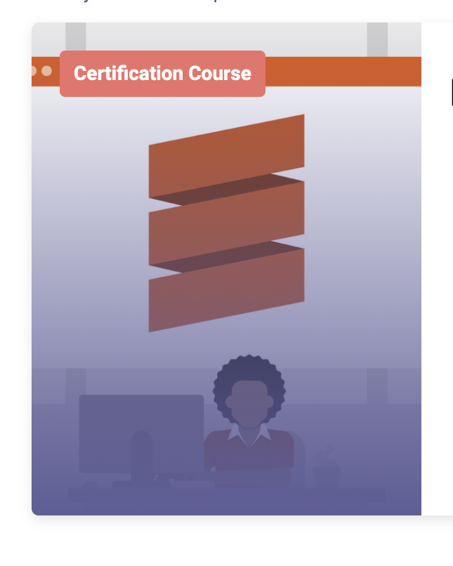
Where to start?
FamilyID=Office_ArchiveTorn
Notes:
https://coursesity.com/course-detail/learning-scala-web-development https://www.youtube.com/watch?v=JzqsPXn3JcU https://www.youtube.com/watch?v=WXwYfy4IbZM

Slide 5
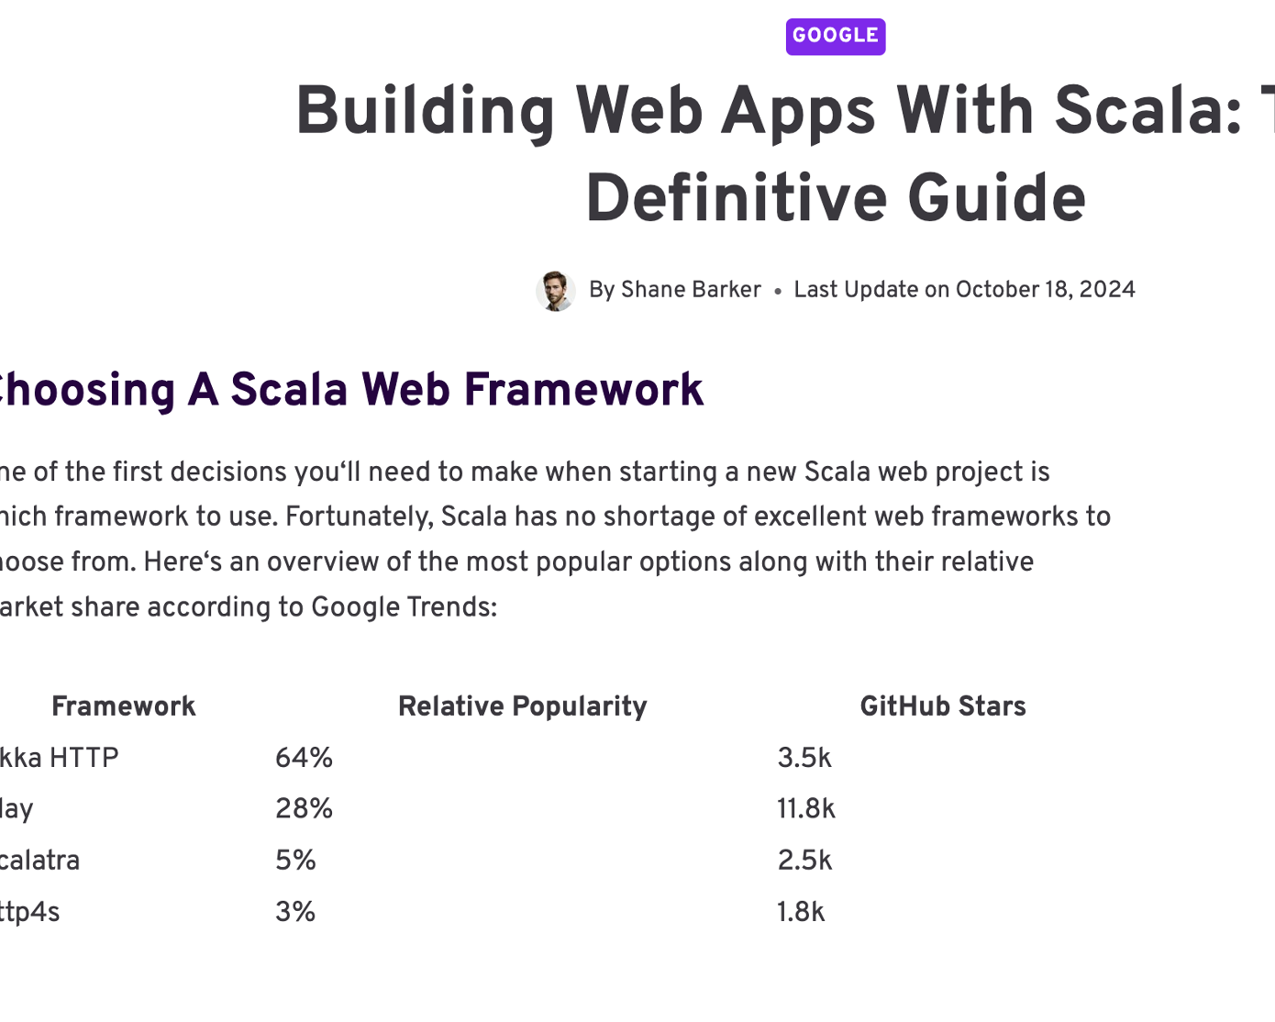
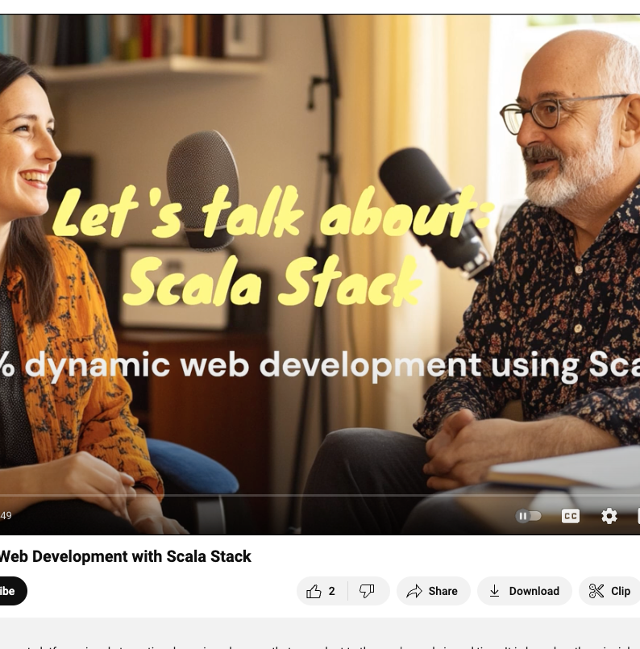
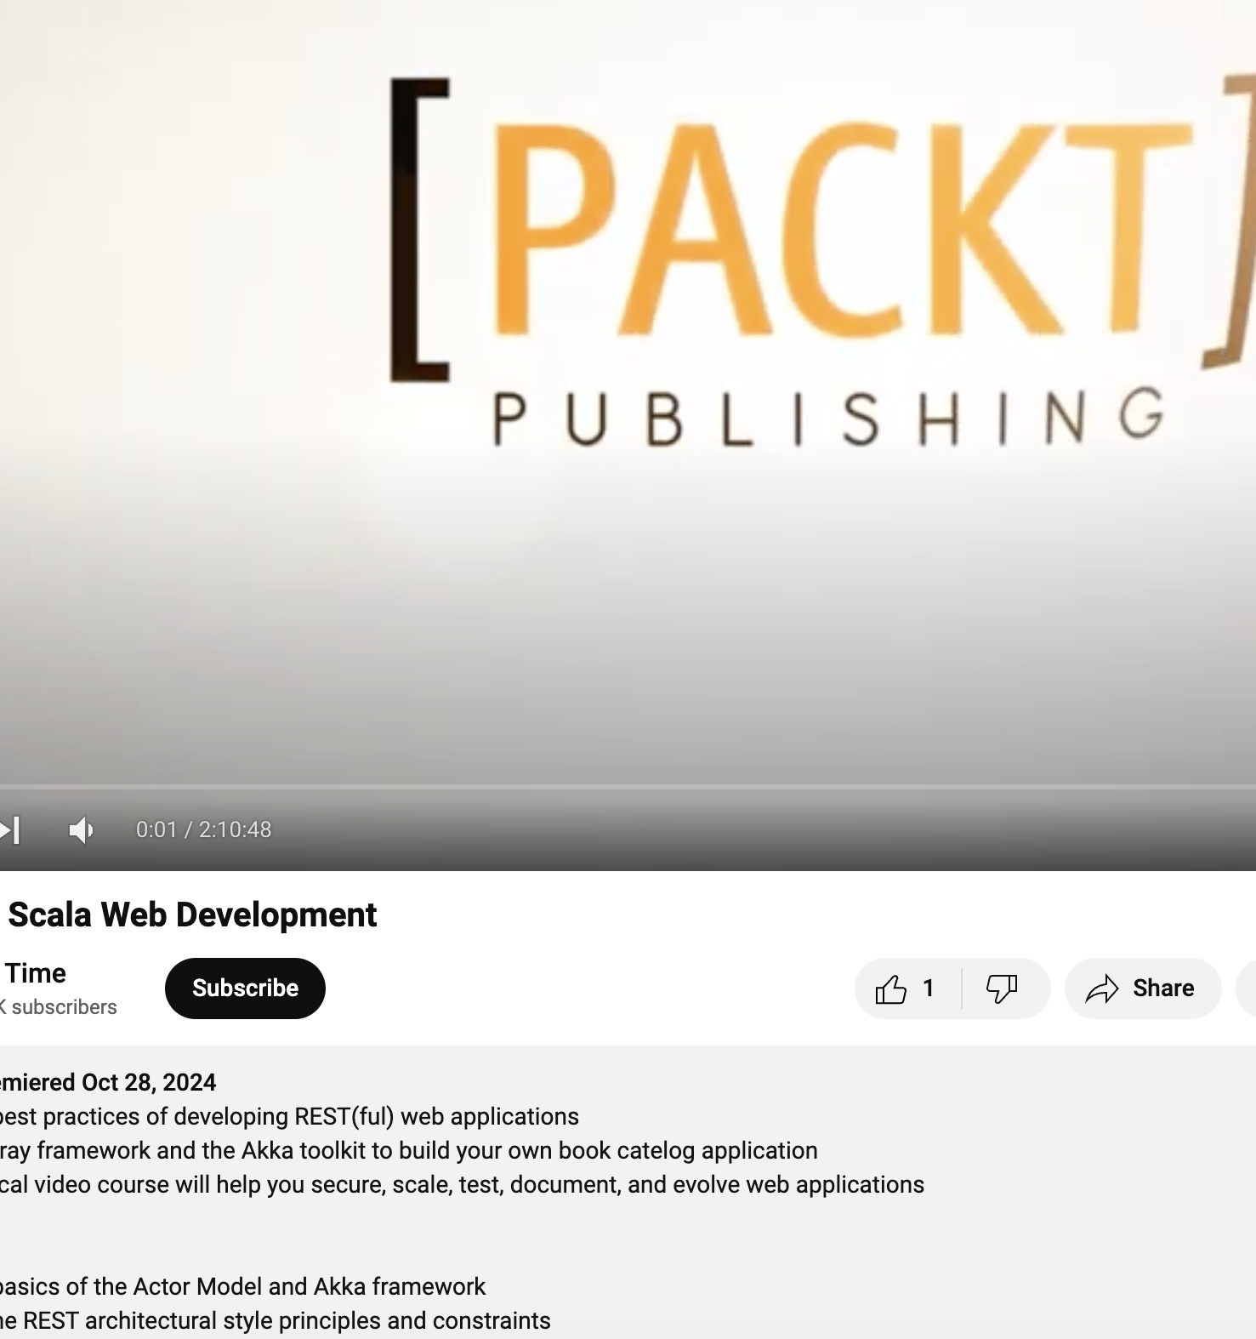
Where to start?
Notes:
https://coursesity.com/course-detail/learning-scala-web-development https://www.youtube.com/watch?v=JzqsPXn3JcU https://www.youtube.com/watch?v=WXwYfy4IbZM

Slide 6
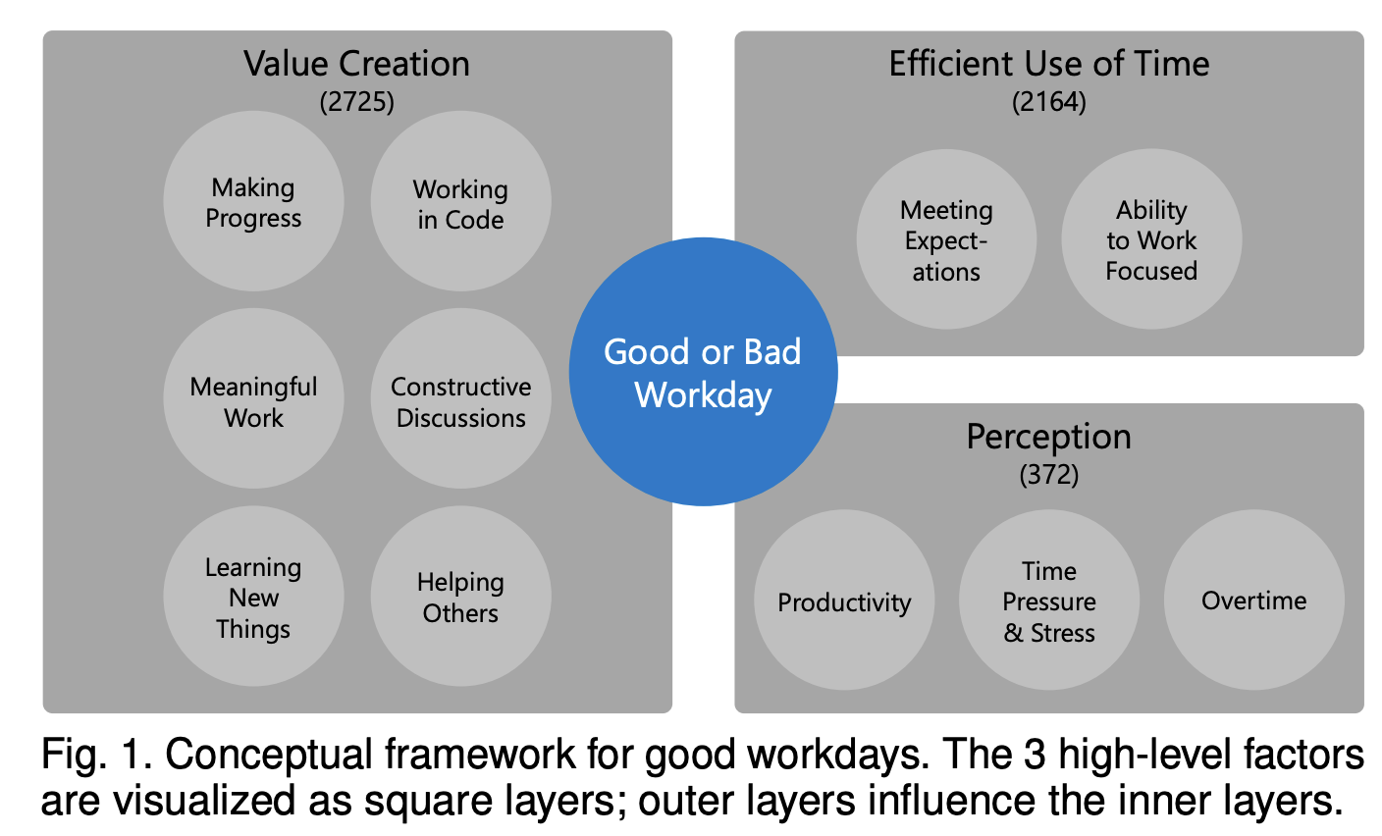
What we do in daily development
Today was a Good Day: The Daily Life of Software Developers Andre N. Meyer, Earl T. Barr, Christian Bird, ´ Member, IEEE, and Thomas Zimmermann, Member, IEEE

Slide 7
Scala web application
configuration
Routing & Endpoints
Business Logic
Repositories & DAOs
Domain model
Utilities & Helpers
Application Entry & Bootstrapping
Testing
Notes:
For a more abstract look at a typical Scala web application project with database integration, here’s a breakdown of the main "building blocks" that can serve as flexible layers or components. This approach focuses on organizing your project around functionality rather than strict folder structures, which can adapt to different frameworks or specific architectural needs. Here’s a typical modular breakdown:
1. Configuration Block
Purpose: Centralizes all configuration management for the app (e.g., database credentials, server settings, environment variables).
Tools: Often uses Typesafe Config, PureConfig, or similar libraries.
Structure: A Config object or class loads settings from configuration files like application.conf. Environment-specific configurations (e.g., for development, testing, production) are also handled here.
2. Controller Layer (Routing & Endpoints)
Purpose: Manages HTTP endpoints, routing incoming requests, and shaping outgoing responses.
Tools: Framework-dependent; could be Http4s for functional routing, Play for MVC-like structure, or Akka HTTP.
Structure: Each controller or route handler manages one area of functionality (e.g., UserRoutes, BookRoutes), interacting with Services to retrieve data or perform actions.
3. Service Layer (Business Logic)
Purpose: Houses the core business logic, connecting various parts of the application. This layer focuses on processing and orchestrating data from multiple sources.
Tools: No specific tools; usually pure Scala code.
Structure: Comprises service classes that implement business logic, generally without direct dependency on external data sources (like databases). For instance, UserService might handle operations related to user data.
4. Persistence Layer (Repositories & DAOs)
Purpose: Manages database interactions, serving as an interface between the business logic and the database.
Tools: Libraries like Doobie, Slick, or Quill are common for database operations in Scala.
Structure: Repositories are responsible for specific data entities, encapsulating CRUD operations and complex queries. They interact directly with the database and abstract out persistence logic for other parts of the app.
5. Domain Model Block (Data Structures & Types)
Purpose: Defines data models and types representing real-world concepts within the application. Domain models should reflect the business requirements and application logic rather than database structure.
Tools: Case classes and ADTs (Algebraic Data Types) are common.
Structure: Models can be divided into domain models (used across the app) and database models (specific to the database structure). Conversions or mappings between these may occur in the persistence layer.
6. Utilities & Helpers
Purpose: Provides utility functions, reusable components, and helpers to streamline development and keep code DRY (Don’t Repeat Yourself).
Tools: Often plain Scala objects or utility libraries.
Structure: Includes helper functions for logging, error handling, request/response transformations, and configuration parsing, depending on what the application needs.
7. Application Entry & Bootstrapping
Purpose: Initiates the application, handling server startup, dependency injection, and any required initializations.
Tools: Often includes framework bootstrapping (e.g., Http4s HttpApp or Play’s built-in server), as well as dependency injection libraries (if needed).
Structure: An entry point (e.g., Main or App) orchestrates all components, wiring dependencies, and setting up the server to start handling requests.
8. Testing Block
Purpose: Provides tests for all layers, from unit tests to integration and end-to-end tests, ensuring the application functions as expected.
Tools: ScalaTest, MUnit, and embedded databases for integration tests.
Structure: Organized by feature or layer, with individual tests covering controllers, services, and repository functions, as well as any core business logic.
Project Flow
With this structure, data typically flows from a request to a controller, through the service layer, and into the persistence layer if database access is required. Each layer handles its specific responsibilities, promoting modularity, testability, and a clean separation of concerns.

Slide 8
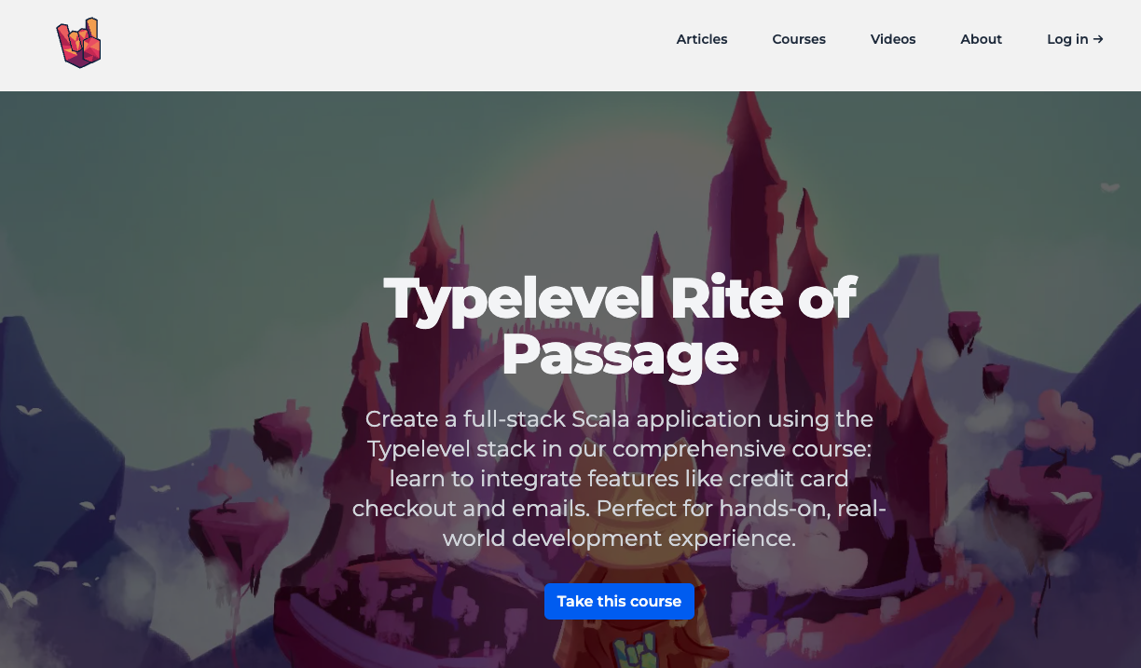
Structured learning path – way to go
You are going to choose not best, but the one with docs and support and learning materials
https://github.com/rockthejvm/full-stack-typelevel-demo
Notes:
Given my FP background, I wanted to find a stack that could leverage those skills. I landed on the TypeLevel ecosystem for its rich functional programming libraries, especially Doobie, Http4s, and Cats Effect for backend processing, as well as ScalaJS and Tyrian on the frontend. However, finding a tech stack isn’t only about what’s ‘best’ but about what aligns with your experience and project needs. I’ll talk more about my specific choices and some of the trade-offs I had to make."

Slide 9
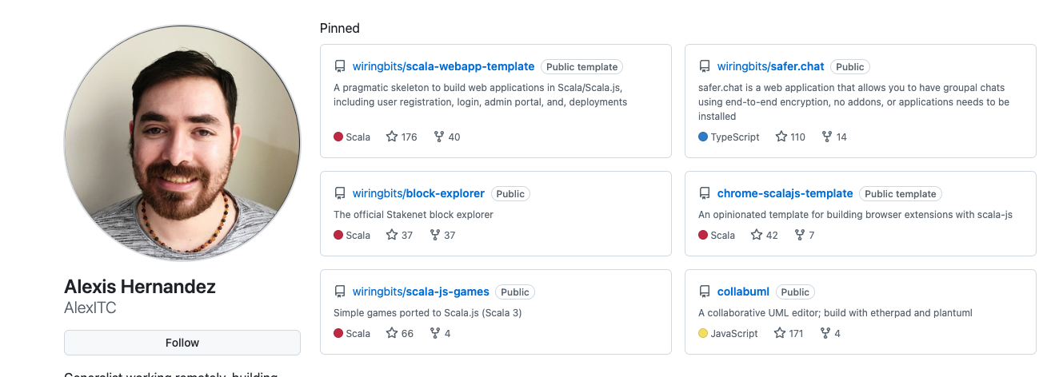

Slide 10
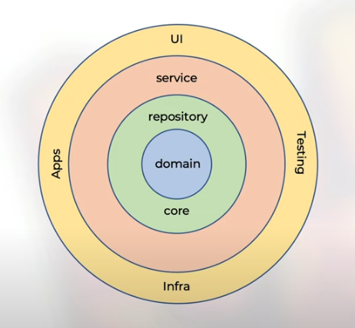
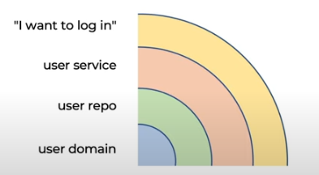
Architecture
Onionex
Onion with some layer segmented
Hex without the ceremony
https://courses.rockthejvm.com/courses/enrolled/2032141

Slide 11
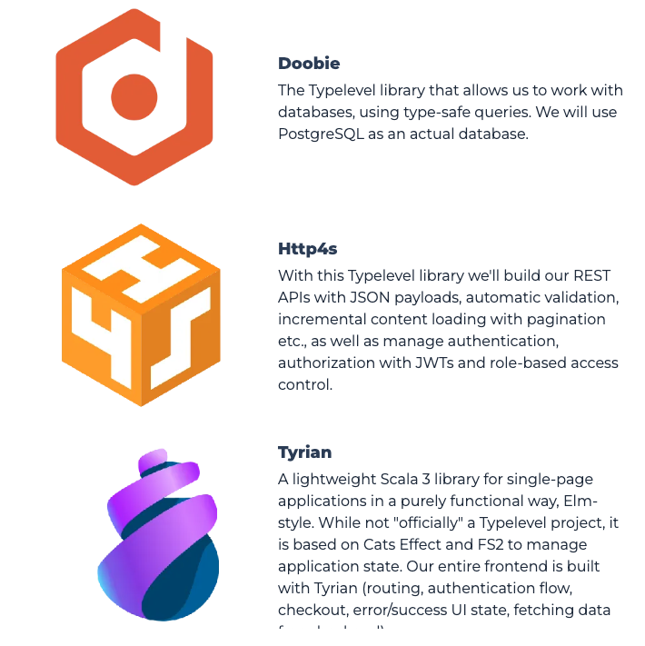
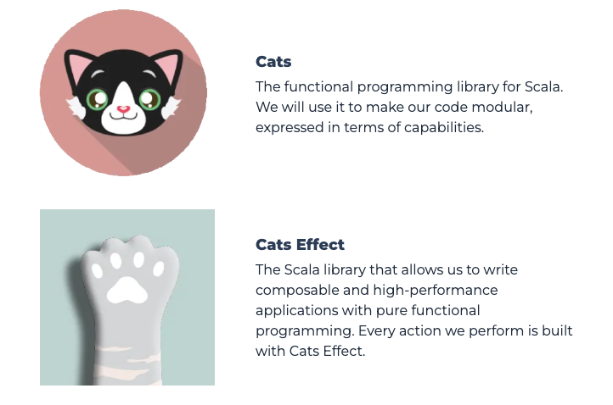
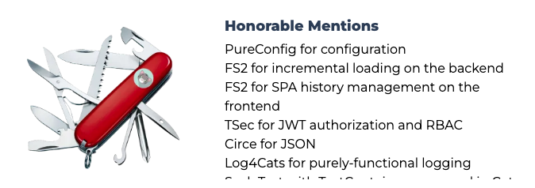
The Tech Stack
Notes:
Given my FP background, I wanted to find a stack that could leverage those skills. I landed on the TypeLevel ecosystem for its rich functional programming libraries, especially Doobie, Http4s, and Cats Effect for backend processing, as well as ScalaJS and Tyrian on the frontend. However, finding a tech stack isn’t only about what’s ‘best’ but about what aligns with your experience and project needs. I’ll talk more about my specific choices and some of the trade-offs I had to make."

Slide 12
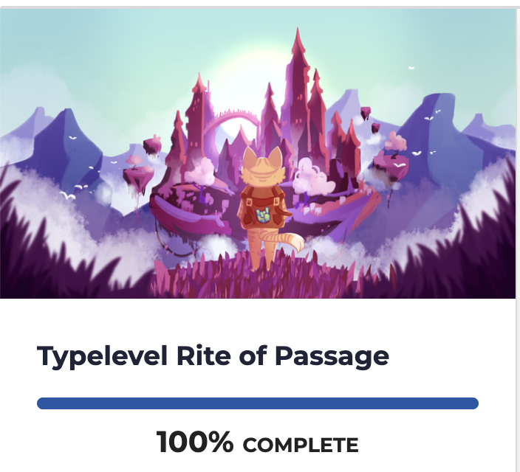
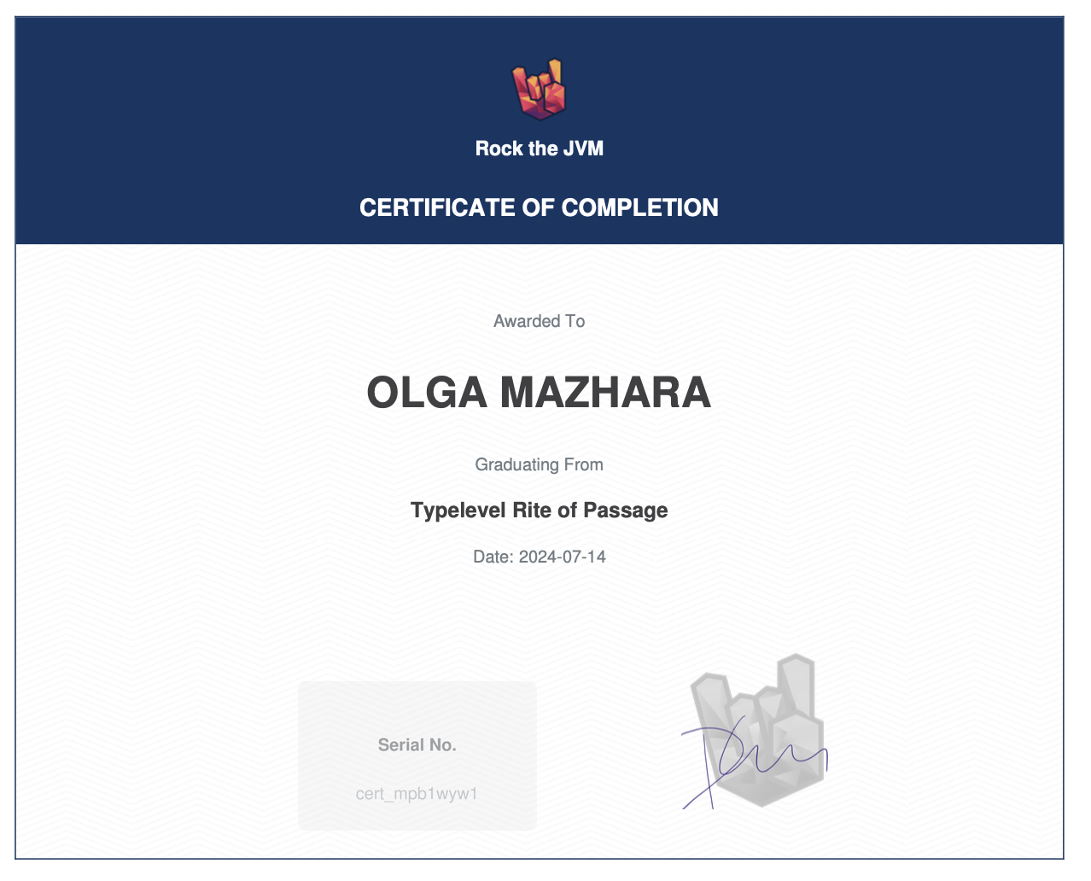
So… 200 hours later you are ready to develop new web site?

Slide 13


Slide 14

Course Theory vs. Real-World Practice
Course project gives you quick set up – easy to start (note: write readme and describe how to run you project)
Usually, your real-life project is different and not straight forward (note: oversimplify at the beginning)
Let’s see some examples
Notes:
In courses and books, web development often looks straightforward. But when I started, I quickly ran into common issues that weren’t covered in tutorials. Missing configurations, lack of tests, version mismatches, and, of course, sparse documentation were the biggest roadblocks. Real-life projects tend to be a lot messier. This talk will highlight some of those pitfalls and how I worked through them.

Slide 15

Real-Life Project – Toloka Association Case Study
Pet Project, Not Just a Hobby Treat your pet project as a valuable resource for learning and growth.
Understand Your Domain Take the time to thoroughly understand the problem space you’re working in.
Respect Existing Solutions Recognize and learn from what has already been created. Always ask yourself why things were done a certain way.
Notes:
Script: "For some context, the Toloka Association needed a library system where volunteers could easily onboard, access books, and manage their tasks. We didn’t need complex analytics, just a straightforward, secure system that would be quick for new users to learn. Choosing tech that met these goals while also being reliable wasn’t as simple as I thought. I learned a lot about aligning project requirements with available tech."

Slide 16
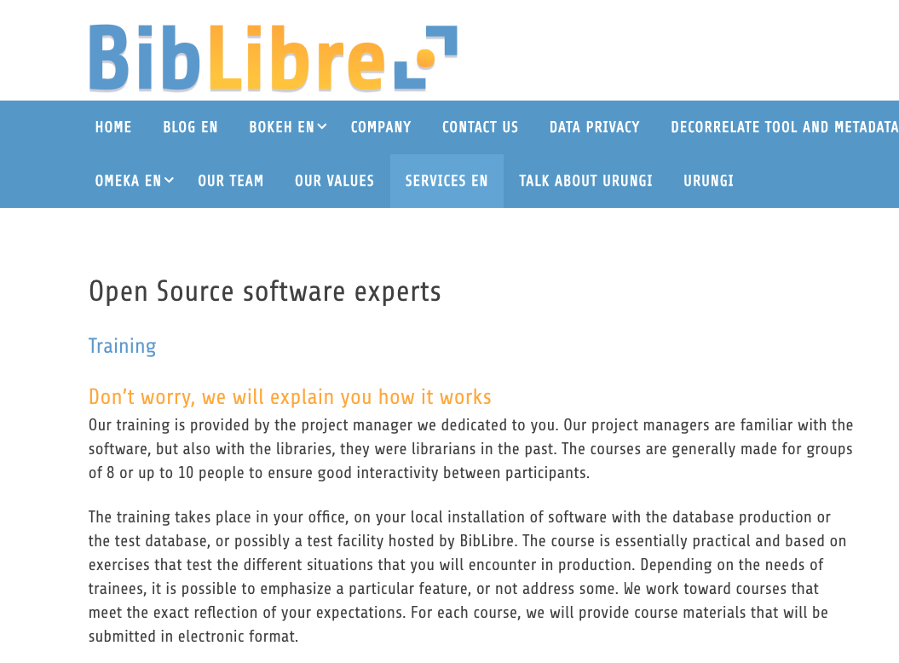
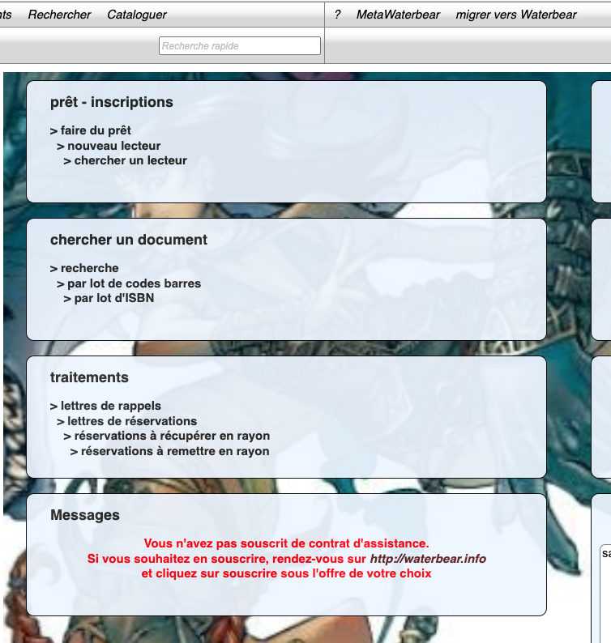
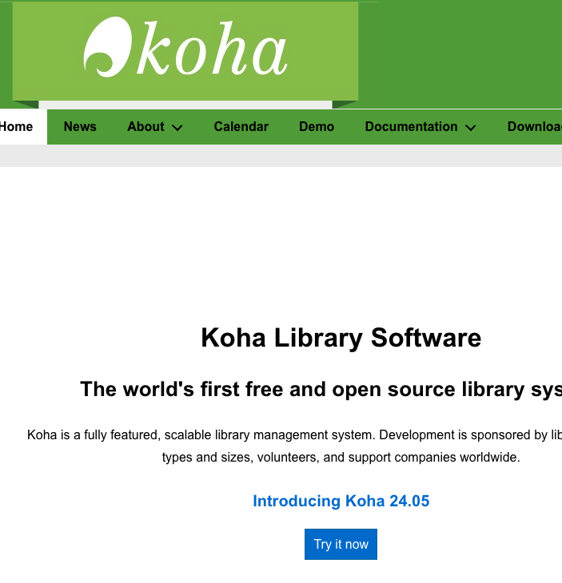
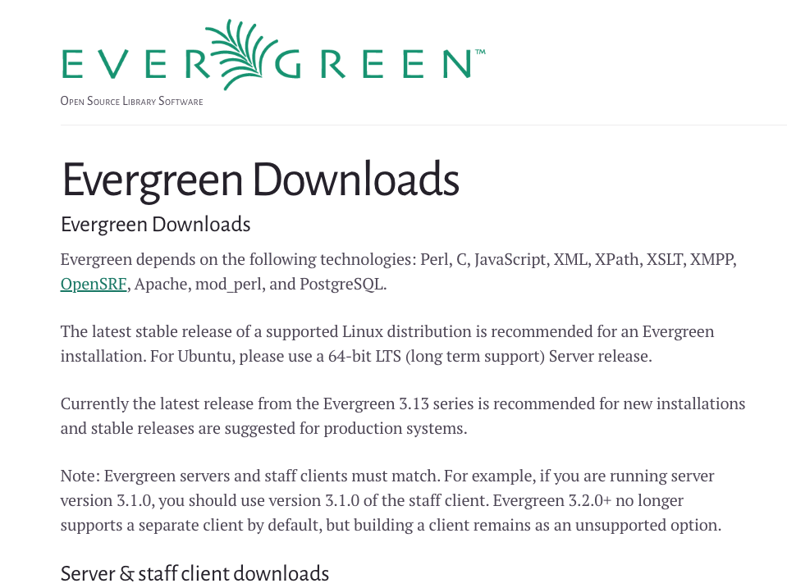

Slide 17
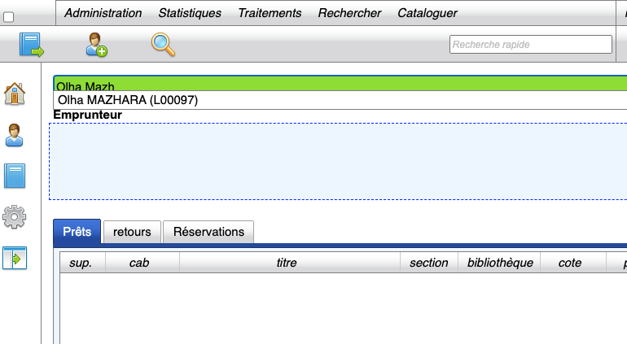
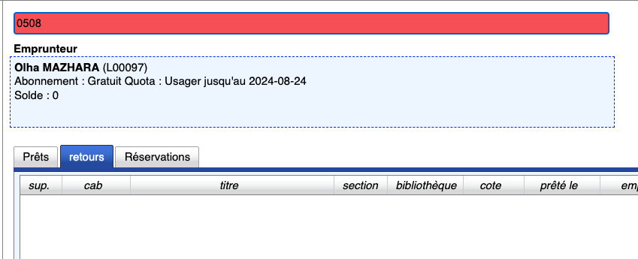
Problem with curent solution
Non-Intuitive Interface: Key tasks, like viewing all loaned books, are hard to find.
Messaging Glitches: Encoding errors caused unreadable messages to all users.
Confusing Search: Searching users and books in the same field leads to frequent errors.
Complex Loan Workflow: Loaning books requires unnecessary steps, slowing down the process.
Lack of Customization: Limited options for tailoring to specific needs.

Slide 18

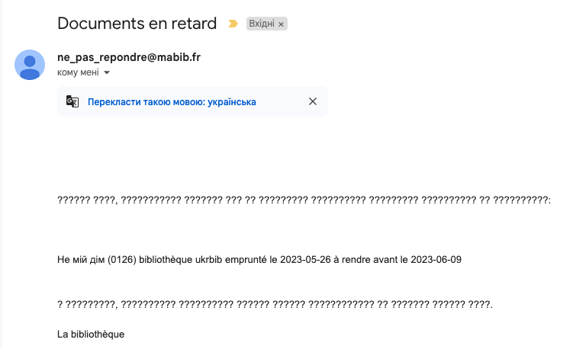
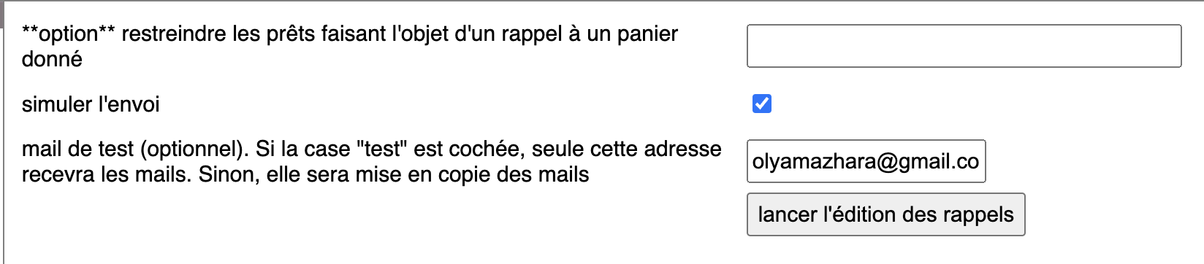
Problem with curent solution
Non-Intuitive Interface: Key tasks, like viewing all loaned books, are hard to find.
Messaging Glitches: Encoding errors caused unreadable messages to all users.
Confusing Search: Searching users and books in the same field leads to frequent errors.
Complex Loan Workflow: Loaning books requires unnecessary steps, slowing down the process.
Lack of Customization: Limited options for tailoring to specific needs.

Slide 19

Why we are special. Toloka Library Requirements vs. Standard Library:
Size: ~1,000 books and 150 users, manageable yet focused on efficiency.
User Experience: Designed for simplicity; must be easy for first-time librarians with no prior experience.
Quick Onboarding: Minimal training needed; clear instructions and intuitive workflows.
Volunteer-Friendly: Flexible roles, supporting rotating staff with minimal tech background.
Security: Simple but effective; ensures user privacy and controlled access without complex protocols.
Community-Focused: Emphasizes accessibility and ease of access over advanced features.

Slide 20


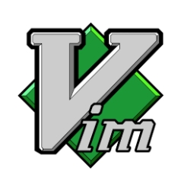


Difficulty #0: Navigating Unfamiliar Development Tools

Slide 21


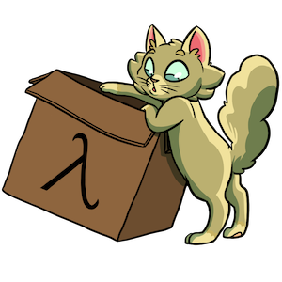
Building the Backend
Cats for FP abstractions and extension methods
Cats Effect for effectful operations
doobie for database interactions
http4s for a purely functional web server
Notes:
"On the backend, we used Doobie for SQL and database handling, Http4s to build the REST API, and Cats Effect to manage side effects. These tools gave us a strong FP backbone, but the learning curve was significant. But the FP benefits, like type safety and immutability, were worth the effort for this project."

Slide 22
Benefits of a Course with Full Backend Setup:
Curated Tools: Focus on functionality, not setup.
Organized Structure: Clear project layout as a guide.
Managed Dependencies: sbt versioning avoids conflicts.
Docker Environment: Easy setup, runs anywhere.
Pre-Configured Testing: Docker tests reduce local issues.
Less Configuration: Jump straight into coding.
Real-World Practices: Learn patterns for production apps.

Slide 23
Here are some random problems

Slide 24

Why Documentation Matters
We tried Skunk for other project —fantastic for PostgreSQL, but the documentation didn’t quite meet our needs. Switching to Doobie saved us time with clear examples, stronger community support, and SQL-like syntax that ChatGPT could assist with.
When choosing libraries, good documentation can make all the difference!

Slide 25


SQL error fixing can be difficult because unclear error message
Notes:
Write test and be careful

Slide 26
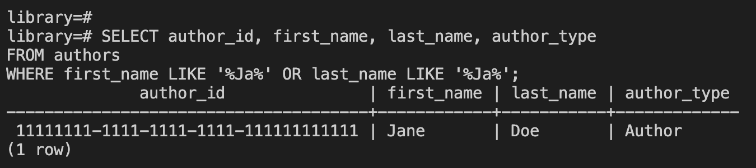
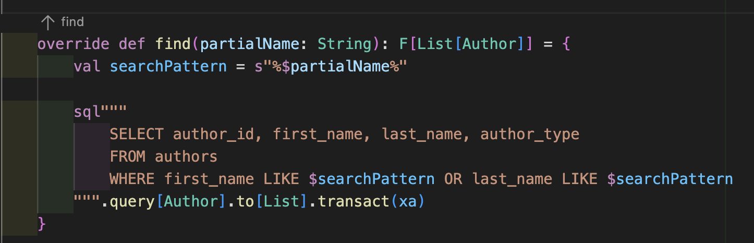
You can make direct request to DB first and then just copy it to your code
Notes:
Write test and be careful

Slide 27
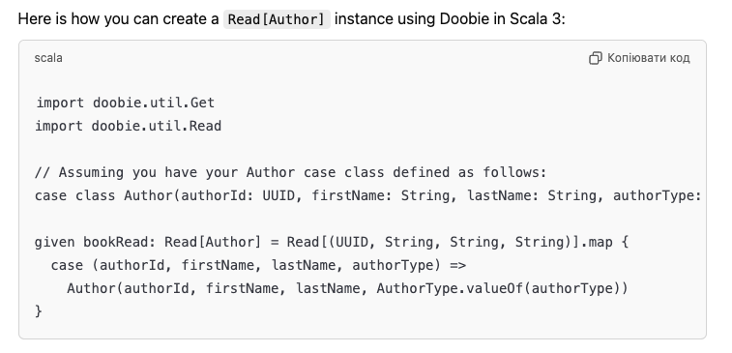
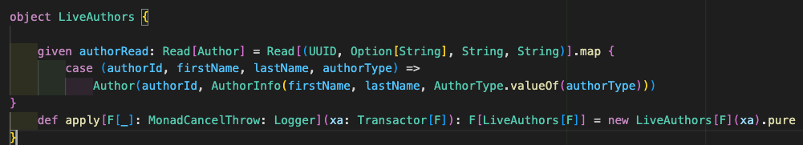
Its better when chatGPT know your lib

Slide 28
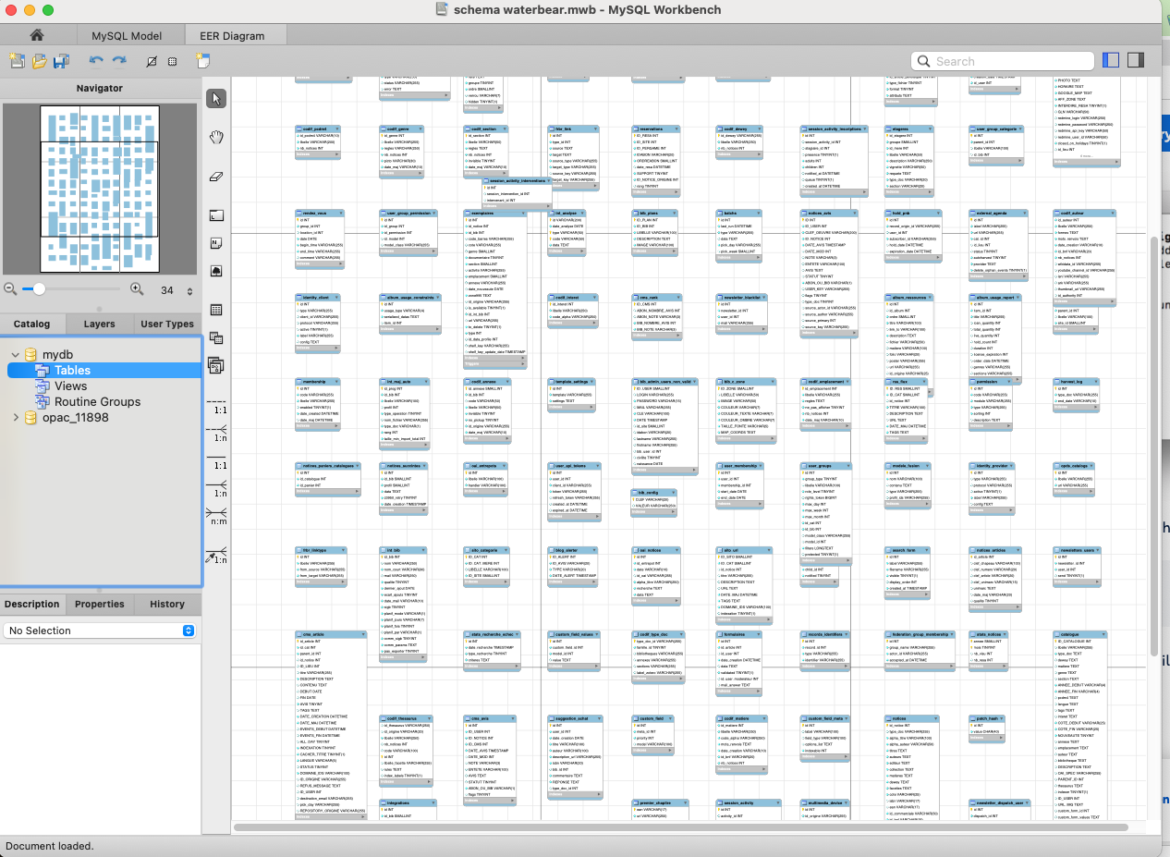
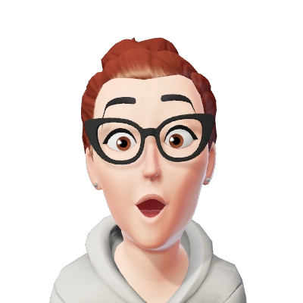
How it is done in current solution?

Slide 29
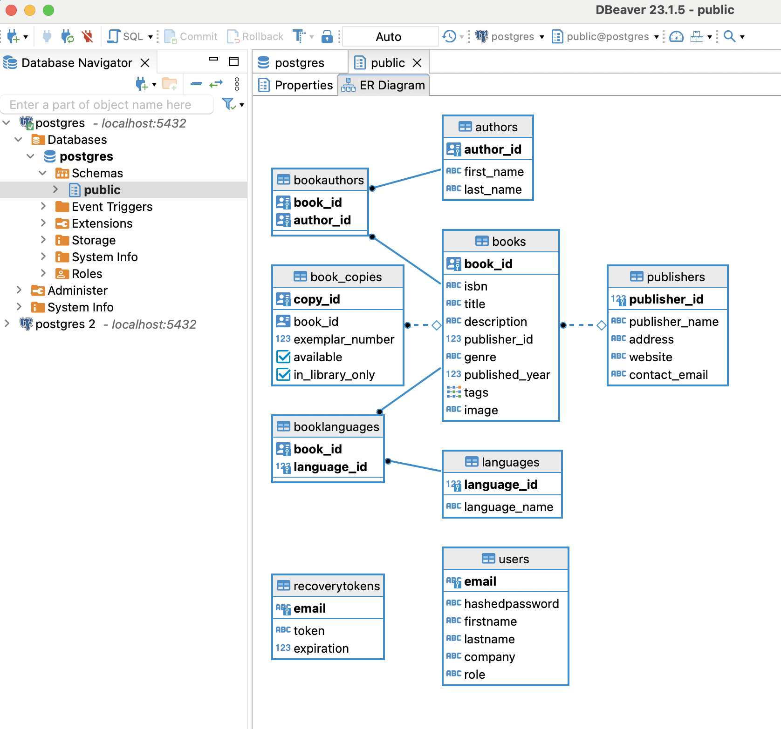
It’s better to start with simpler version

Slide 30
if you need something from cats or cats effects - import *, you will never remember, where this classes located

Slide 31
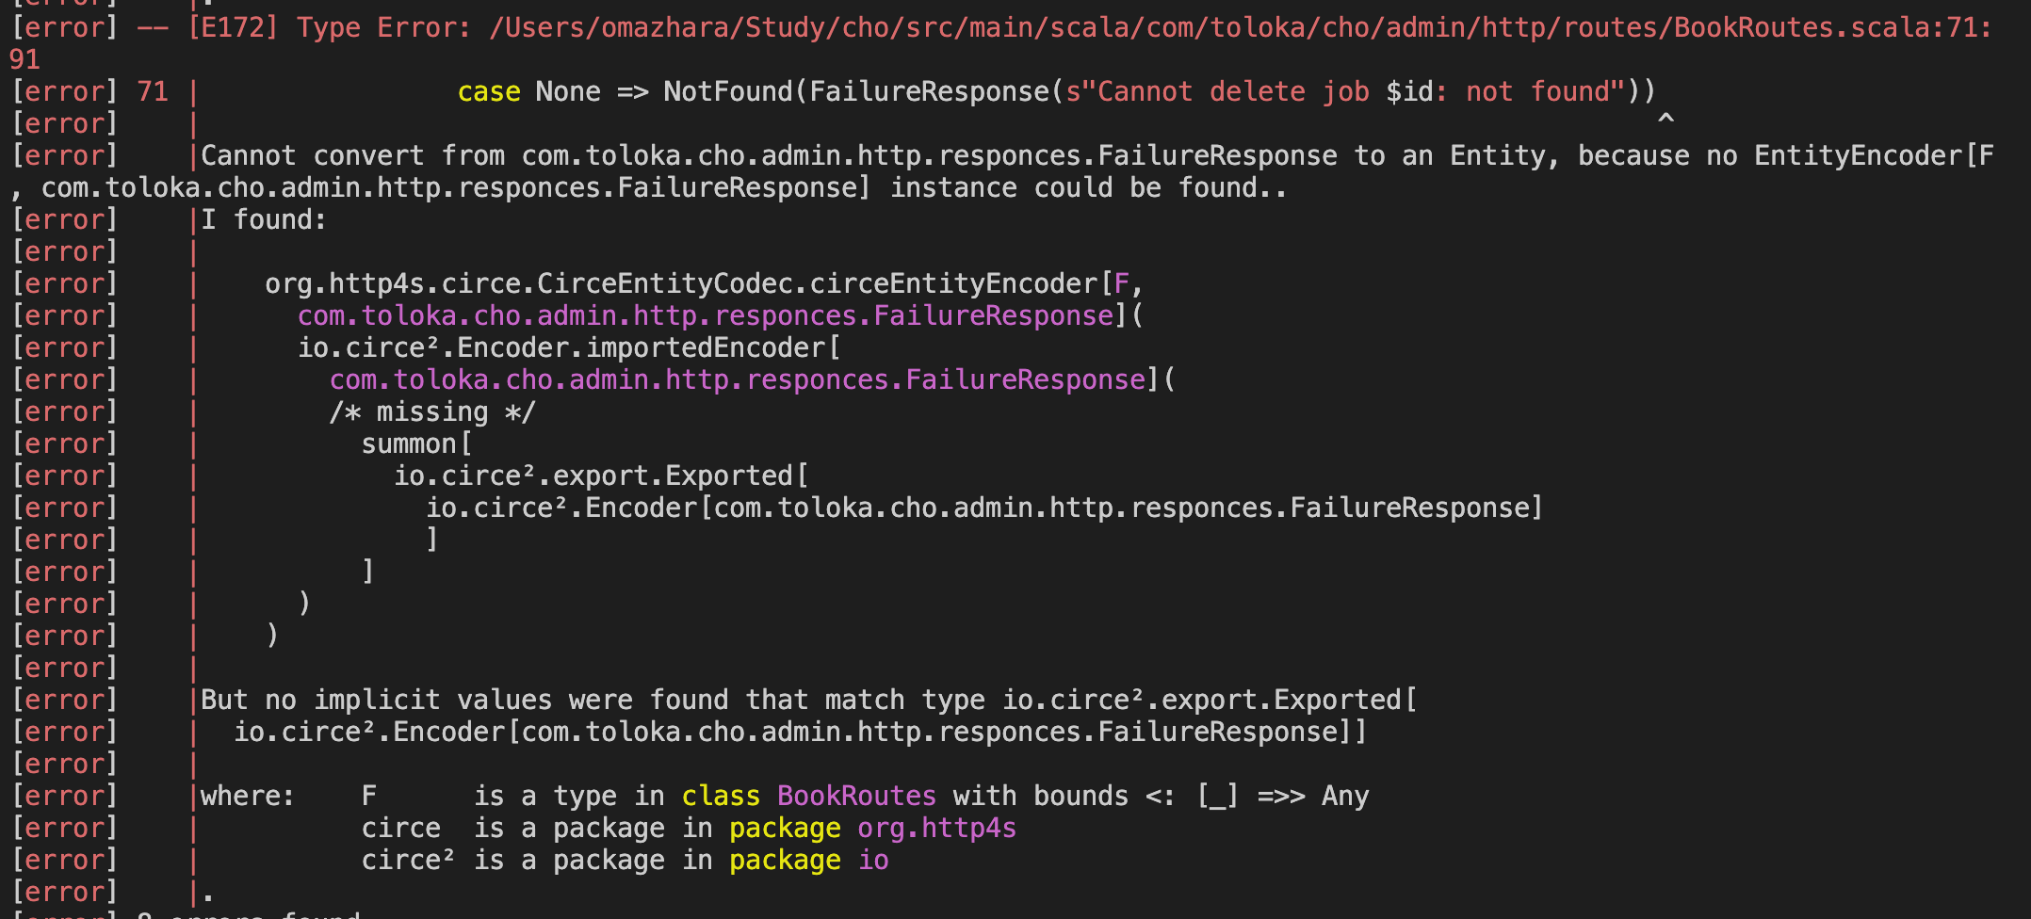
Implicits & Imports

Slide 32
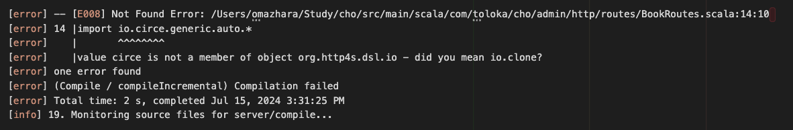
try import import io.circe.generic.auto.*

Slide 33
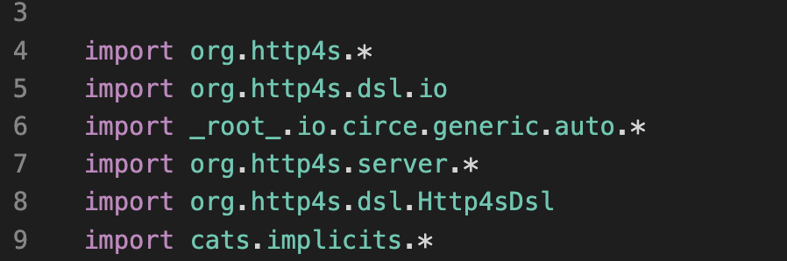
import io.circe.generic.auto.* - import it on very top to avoid error

Slide 34

import pureconfig.generic.derivation.default.* to be able to derive ConfigReader

Slide 35
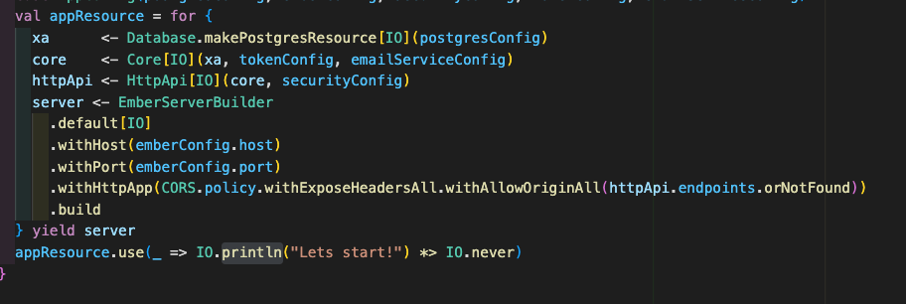
CORS.policy – its good to have slack with answers
Notes:
Cross-origin resource sharing (CORS) is an extension of the same-origin policy. You need it for authorized resource sharing with external third parties. For example, you need CORS when you want to pull data from external APIs that are public or authorized.
https://stackoverflow.com/questions/14681292/same-origin-policy-and-cors-cross-origin-resource-sharing

Slide 36


Tackling the Frontend
Tyrian, a nice frontend library inspired by Elm, based on Cats Effect, for Scala 3 transpiled to JavaScript (ScalaJS)
Notes:
To keep things consistent, we went with ScalaJS for the frontend, with Tyrian as the UI library. This stack kept everything type-safe and let us work within a single language across the full stack. However, using Scala for frontend development has its own quirks—especially when it comes to connecting smoothly with backend systems. It took a lot of tweaking to make everything integrate well."

Slide 37
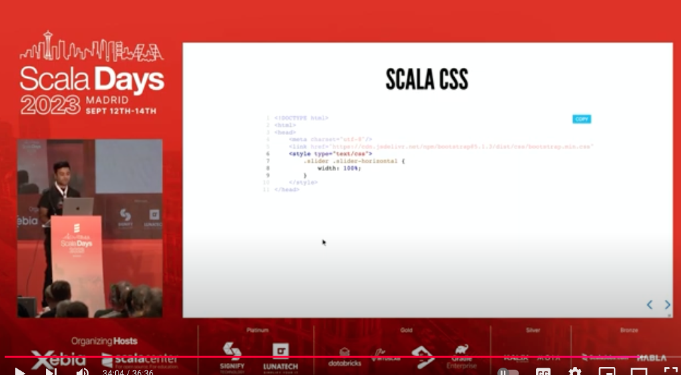
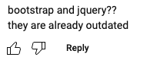

Bootstrap outdated?

Slide 38
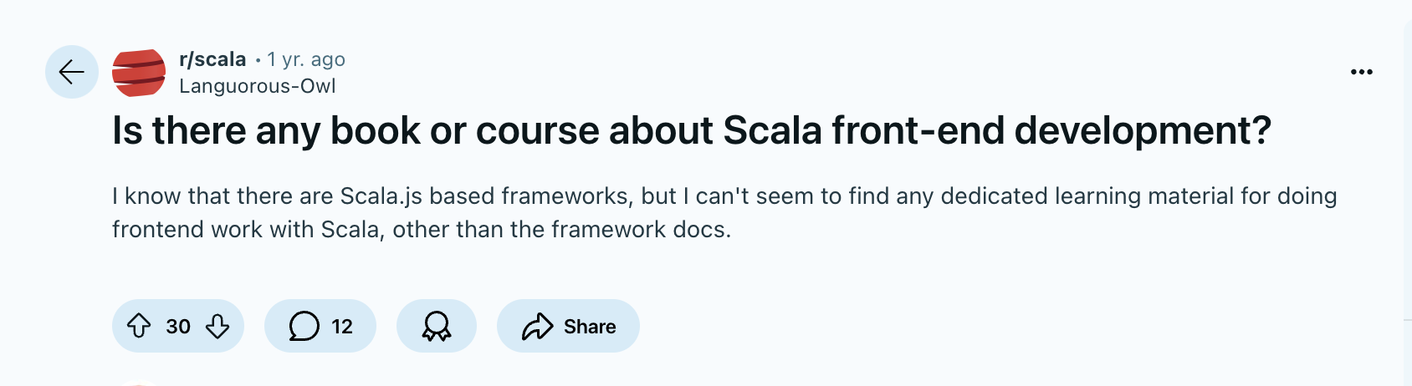
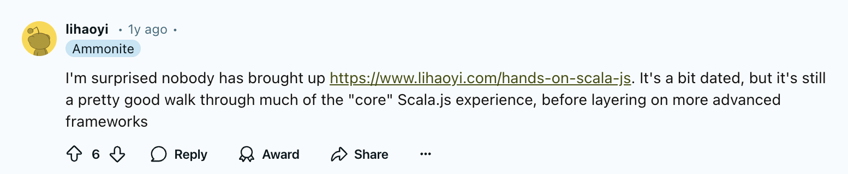
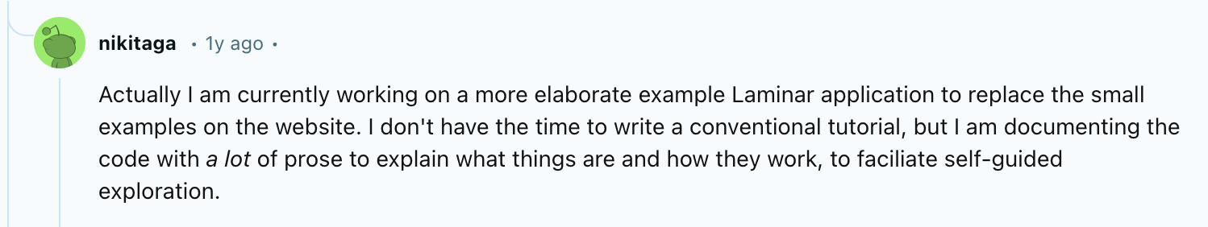
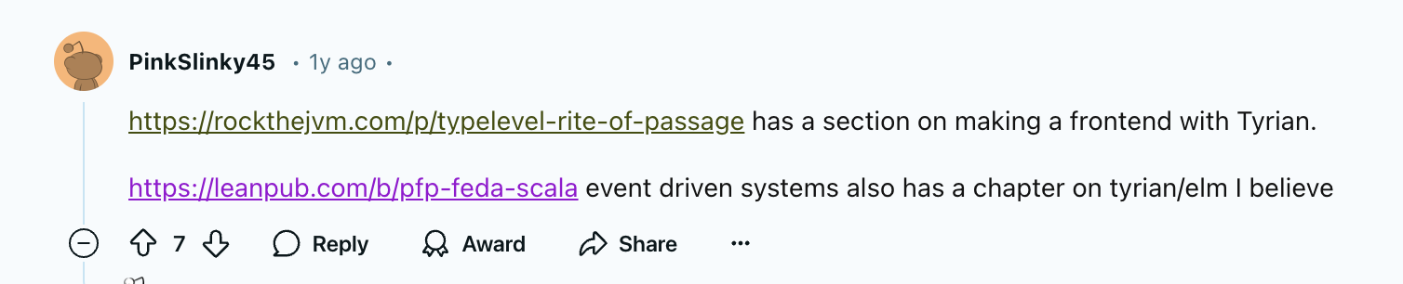
Notes:
https://www.reddit.com/r/scala/comments/173jznv/is_there_any_book_or_course_about_scala_frontend/ https://www.lihaoyi.com/hands-on-scala-js
https://laminar.dev/
https://rockthejvm.com/p/typelevel-rite-of-passage https://blog.indoorvivants.com/2022-06-10-smithy4s-fullstack-part-1
https://github.com/sherpal/LaminarSAPUI5Bindings

Slide 39
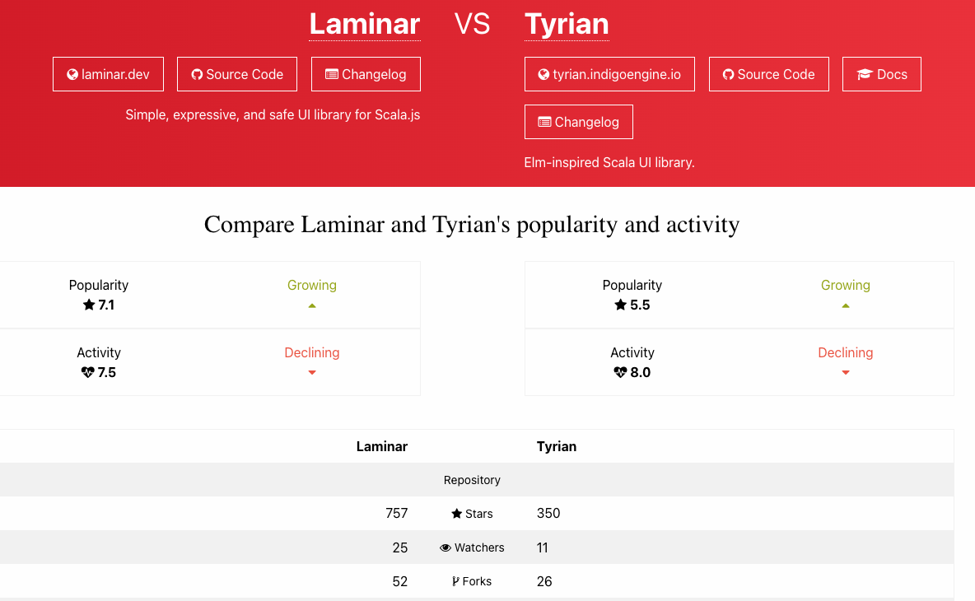

Slide 40
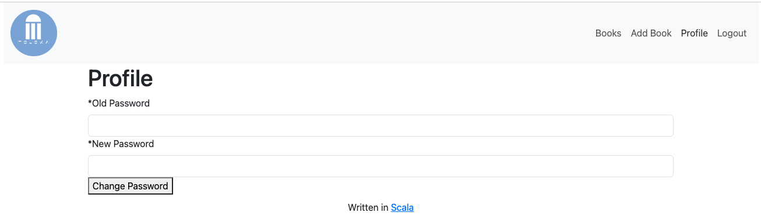
Simplify ui
Notes:
Script: "Now, I’d like to talk about some of the biggest challenges we faced. A major one was documentation, or rather, the lack of it. Even with libraries as popular as Http4s and Doobie, I found myself lost in GitHub issues and scattered tutorials more often than I expected. Another big one was dependency mismatches; sometimes, libraries within the same ecosystem didn’t play well together without a lot of manual configuration. These are common problems in FP projects, but they can be especially discouraging when you're new."

Slide 41
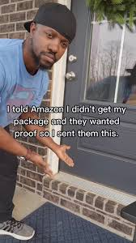
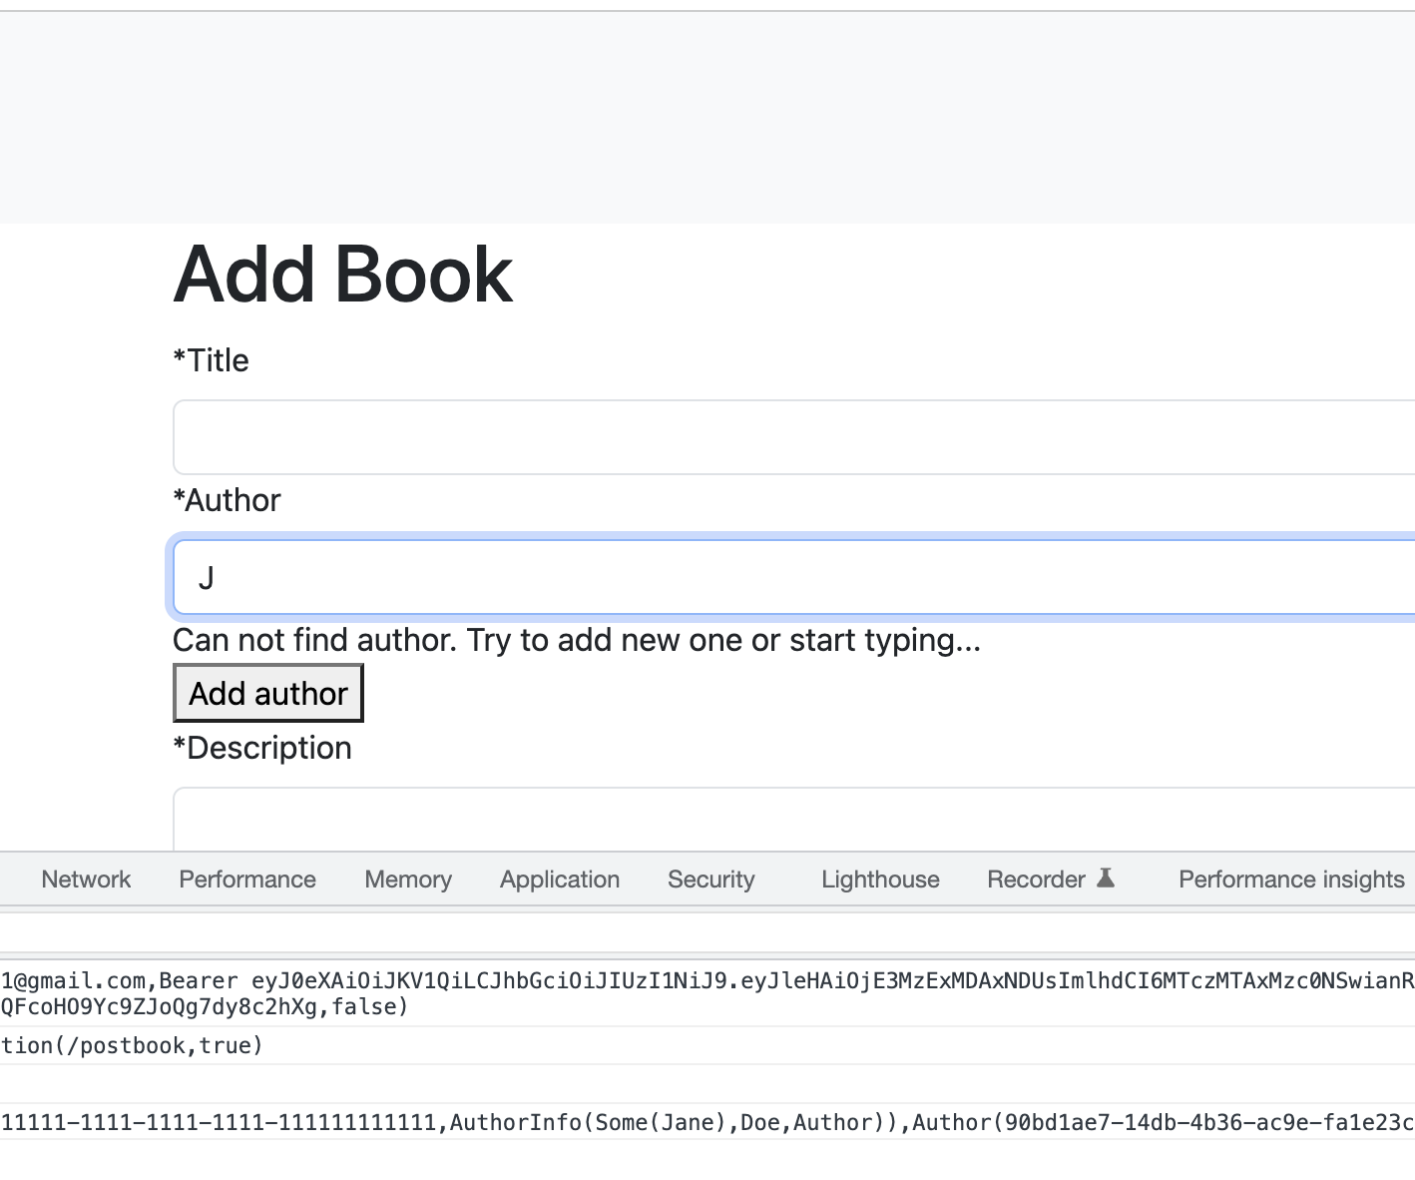

Slide 42

It not always works as you expect

Slide 43


Slide 44
Topics I Wish Were Covered in Courses
Database Migration: Handling schema changes and versioning smoothly, with minimal disruption to data.
Security Essentials: Practical guidance on securing APIs, handling authentication, and managing sensitive data.
Performance Optimization: Techniques for profiling, optimizing queries, and improving overall app speed.
Logging and Monitoring: Setting up meaningful logging and monitoring to track application health and performance.
Integration with Third-Party Services: How to handle social logins, payment gateways, and other external APIs.
Scaling Strategies: Techniques to handle increased load as applications grow, from caching to load balancing.

Slide 45
Key Takeaways
Expect Real-World Challenges: Course examples often skip issues like version mismatches, missing configs, and incomplete tests that can stall projects.
Importance of Good Documentation: Libraries with clear docs save time and ease development, especially with complex stacks.
Choosing the Right Tools: Invest in libraries and frameworks that support your project’s needs, not just the “trendiest” ones.
The Power of Community: Strong community support provides faster answers, resources, and examples when you’re stuck.
Learning from Mistakes: Building projects is an adventure; expect trial and error, and embrace the lessons along the way.
Balance Simplicity and Functionality: Especially in small or volunteer-driven projects, prioritize a setup that new team members can quickly understand and contribute to.
Notes:
"As we wrap up, I want to leave you with a few key points: practical application of knowledge is what builds real-world skills; documentation isn’t just an afterthought—it’s essential; and mistakes are going to happen. Embrace them as part of the learning process. FP in web development has a steep learning curve, but it’s also deeply rewarding if you stick with it."

Slide 46

Q&A
Notes:
Thank you for being such an attentive audience! I’m excited to hear any questions you might have or share more about my experiences. Whether it’s about FP, the TypeLevel stack, or overcoming common web dev pitfalls, I’d be happy to dive in."

